Slide 1
The University with a big heart

Slide 2

Intelligent contract using Blockchain
Resource Person
Mitha Rachel Jose
RDI-Developer
Centria University of Applied Science

Slide 3
Why Blockchain?
To improve the security in keeping records.
To reduce /(avoid) corruption –Digital freedom.
To regain control of our financial privacy.
To full control of our sensitive digital records.
To build a sustainable world to live.
”Blockchain is a brand spanking new technology.”

Slide 4
Software Requirements
Remix IDE:Remix is one of the easiest and browser-based tools to use for the creation and deployment of smart contracts.
Truffle Framework:Truffle is a framework for Ethereum that offers a development environment for building Ethereum based apps.
Solc:Solidity is a loosely typed programming language used for the creation of smart contracts on the Ethereum platform.
Ganache: Ganache is a tool from Truffle Suite that allows developers to create their own private Ethereum blockchain to test dApps.
An editor- eg. Visual Studio code .
Programming Languages:
For smart contract: Solidity
Integration purposes : JavaScript, HTML ,CSS, Ts, Angular cli or React ().

Slide 5
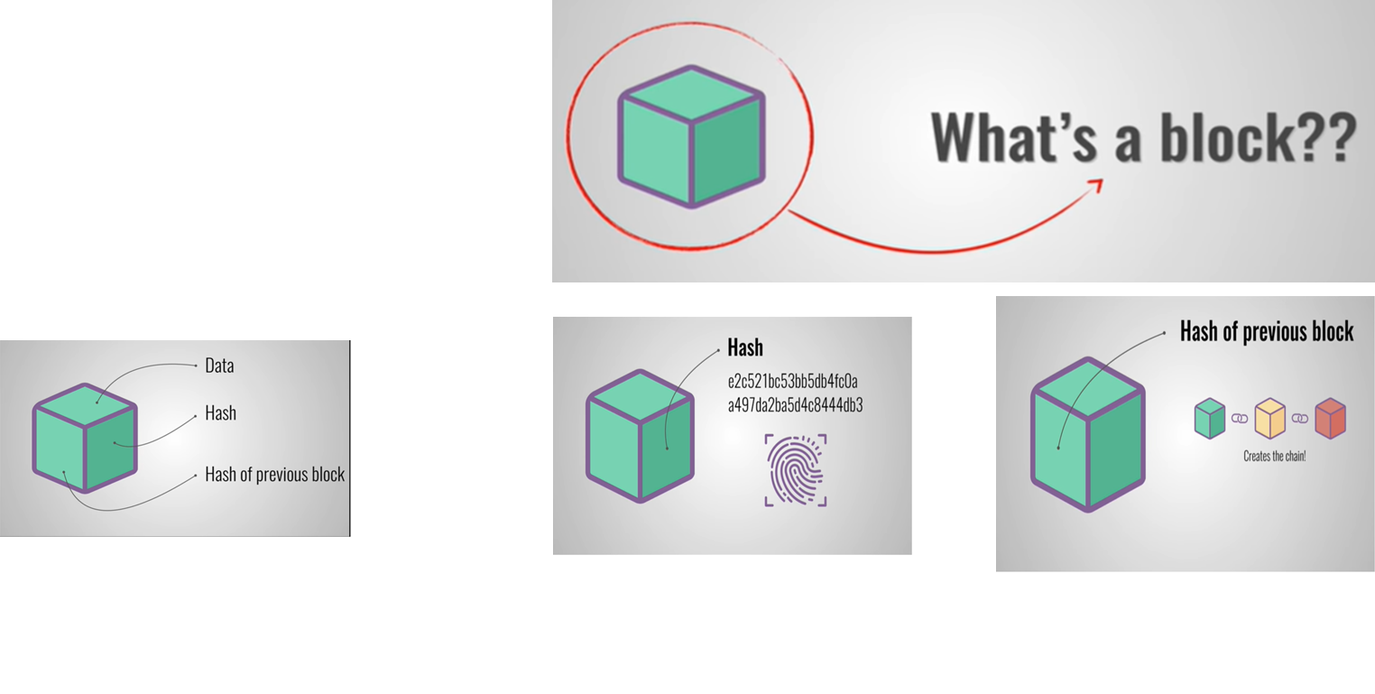
What is Block Chain?
A blockchain is an “open distributed ledger that can record transactions between two parties efficiently and in a verifiable and permanent way”.
A blockchain has a list of blocks. It starts with a single block, called the genesis block.
Each of the block contain
Data
Hash –to uniquely identify the block
Hash of previous block

Slide 6
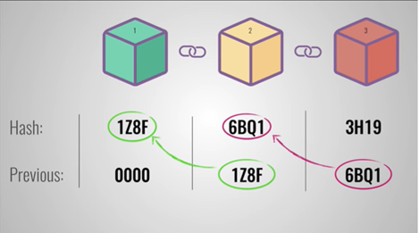
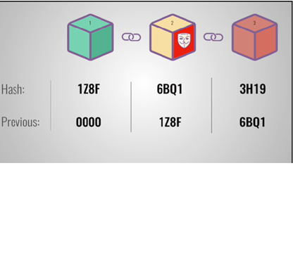
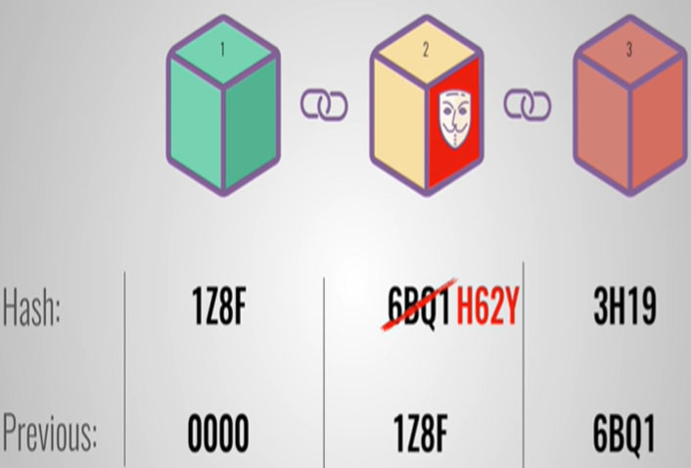
Function of Hash Function

Slide 7
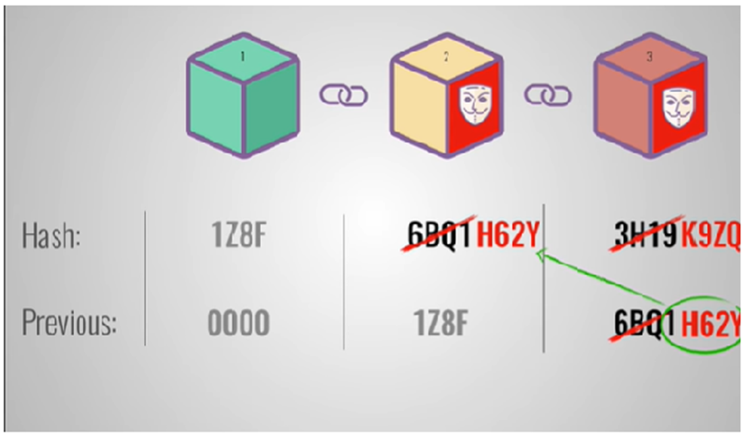

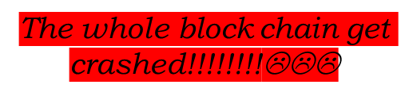
Contd…

Slide 8
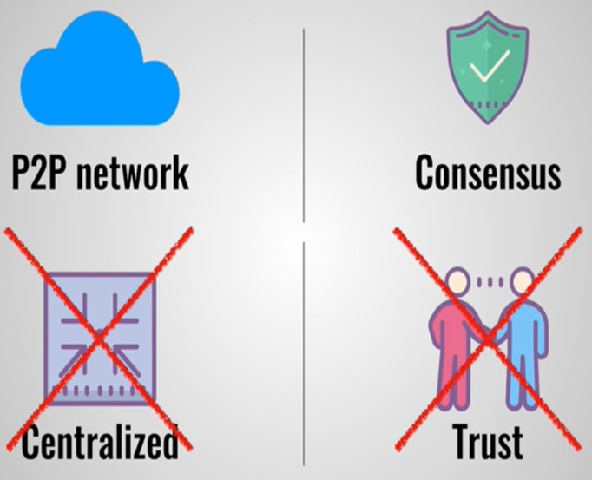
Security Mechanism in Block Chain
P2P Network
Anyone can join in the network.
Consensus Algorithm
(Also called proof of work)
Cryptographic puzzle

Slide 9
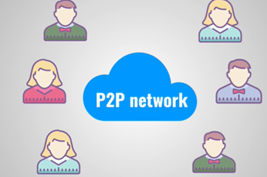
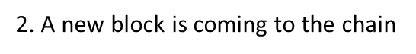
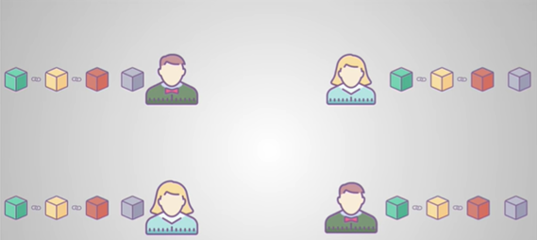
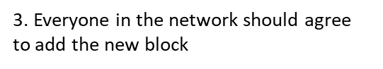
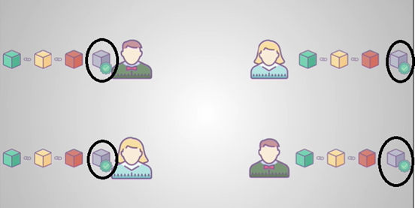
Peer to Peer Network
1. Peer to peer network

Slide 10

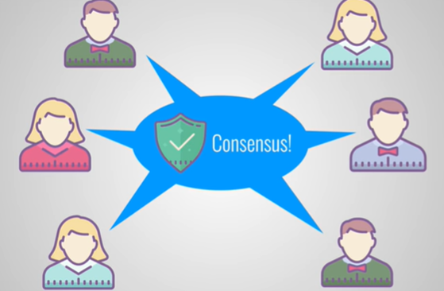
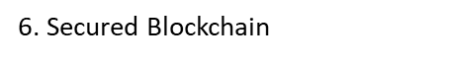
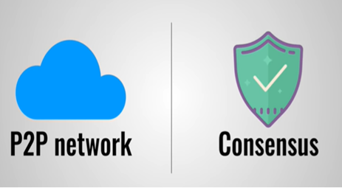
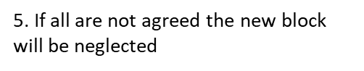
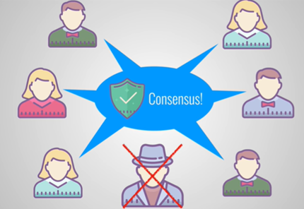
Contd…..

Slide 11
How Block chain transaction works?
Transaction Requested
Validate Transaction
Add To
Blockchain
Broadcast Transaction
1) Some person requests a transaction. The transaction could be involved cryptocurrency, contracts, records or other information.
2. The requested transaction is broadcasted to a P2P network with the help of nodes.
3. The network of nodes validates the transaction and the user's status with the help of known algorithms.
4. Once the transaction is complete the new block is then added to the existing blockchain. In such a way that is permanent and unalterable.

Slide 12
Types and Variants of Blockchain
Four types of blockchain networks
public blockchains
private blockchains
hybrid blockchains
Variants of Block Chain
Public
Absolutely no access restrictions
Any one with a an internet connection can send transactions to it .
Private
Permissioned
Cannot join into it unless invited by the network administrator
Hybrid
Combination of centralized and decentralized features
Eg: Ethereum, Bitcoin
Block chain 1.0
(Currency)
Block chain 2.0
(Smart Contracts)
Block chain 3.0
(DApps)

Slide 13
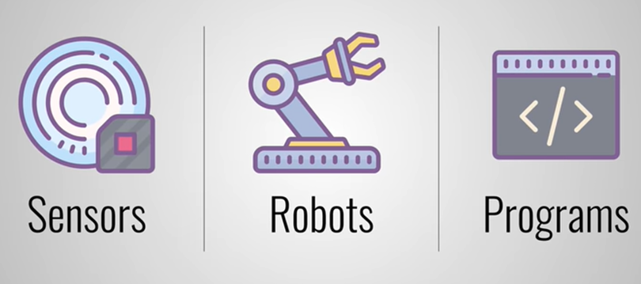
Applications of Block Chain

Slide 14
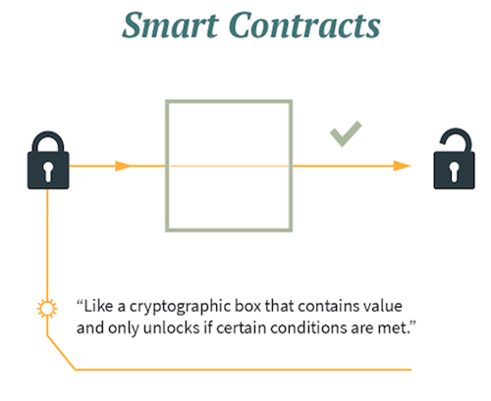
Smart Contracts
A smart contract is a self-enforcing agreement embedded in computer code managed by a blockchain. The code contains a set of rules under which the parties of that smart contract agree to interact with each other.
An example of a smart contract code is given:

Slide 15
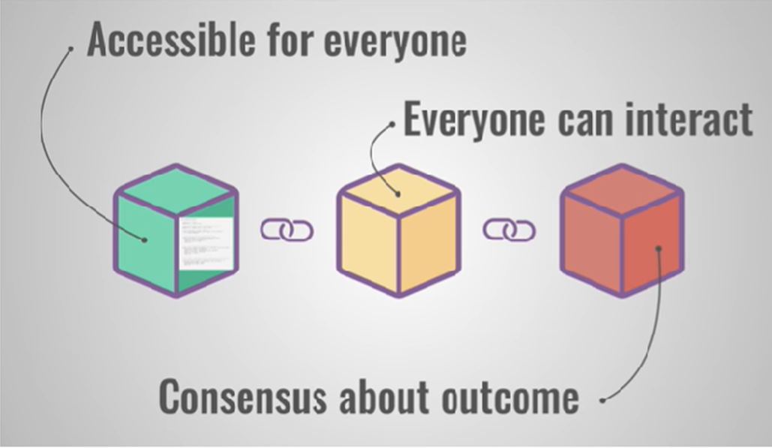

Function of smart contract
Benefits
The contract is immutable
The contract is distributed
The contract is transparent

Slide 16
Use Cases and Advantages of Block Chain
Use Cases | Advantages
Banking and Finance | Reliability
Digital Identity | Unchangeable transactions
Energy and Sustainability | Fraud prevention
Government and the Public Sector | Security
Healthcare and the Life Sciences | Transparency
International Trade and Commodities | Distributed
Law | Decentralized
Supply Chain | Time reduction
Media and Entertainment
Real Estate

Slide 17
Challenges…..!
Smart contracts are still in their developing phase !
vulnerability attacks.
Cybersecurity practices as well as the platforms to create smart contracts need to be updated from time to time.
Care needs to be taken to avoid the risks of code corruption..

Slide 18
Conclusion
Smart contracts have certain advantages for many industry sectors such as
reducing overhead costs
providing transparency
and saving time.
They are more reliable, secure, efficient and trustworthy as compared to paper contracts.

Slide 19

QUESTIONS

Slide 20
Thank you for your interest!

